Slide 1

Video Archives @ wp.nyu.edu/2025notebooklm

Slide 2
17 Featured Use Cases
8 NotebookLM Use Cases for Teaching
4 NotebookLM Use Cases for Academic Operations
3 NotebookLM Use Cases as a Research Partner
2 Studying with NotebookLM Student Use Cases

Slide 3
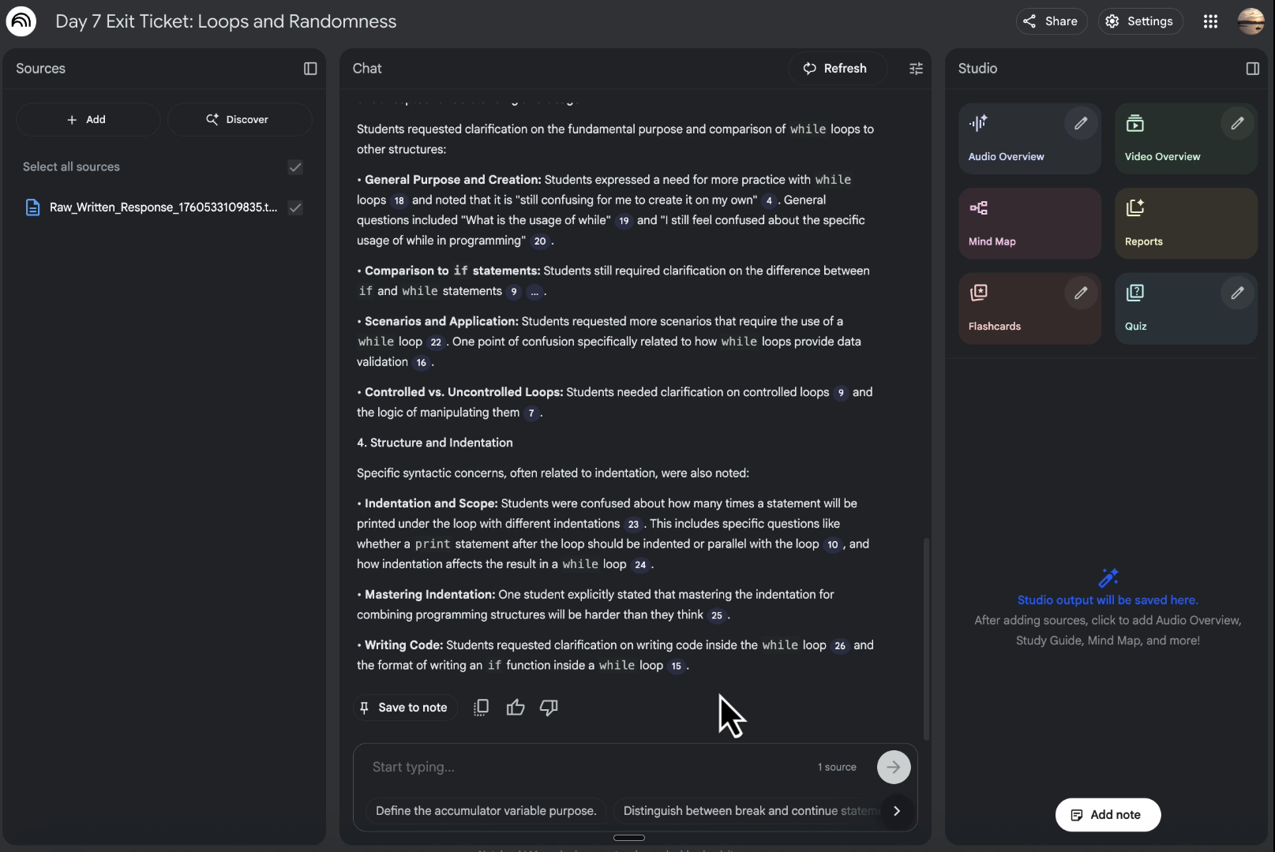
NotebookLM for Teaching
Analyzing Student Feedback Data Using NotebookLM
Craig Kapp
NYU Courant Institute of Mathematical Sciences
Clinical Professor

Slide 4
NotebookLM for Teaching
Other Featured Use Cases
Streamlining Navigation of Complex Readings in Graduate Seminars
Supporting Capstone Projects with a Resource Guide from the Library
Counteracting Confirmation-Based Reading
Identifying Common Student Mistakes and Recurring Feedback Patterns
Developing Lecture Materials and Shared Resources
Organizing and Assessing Historical Information
Teaching Students to Use the Tool

Slide 5
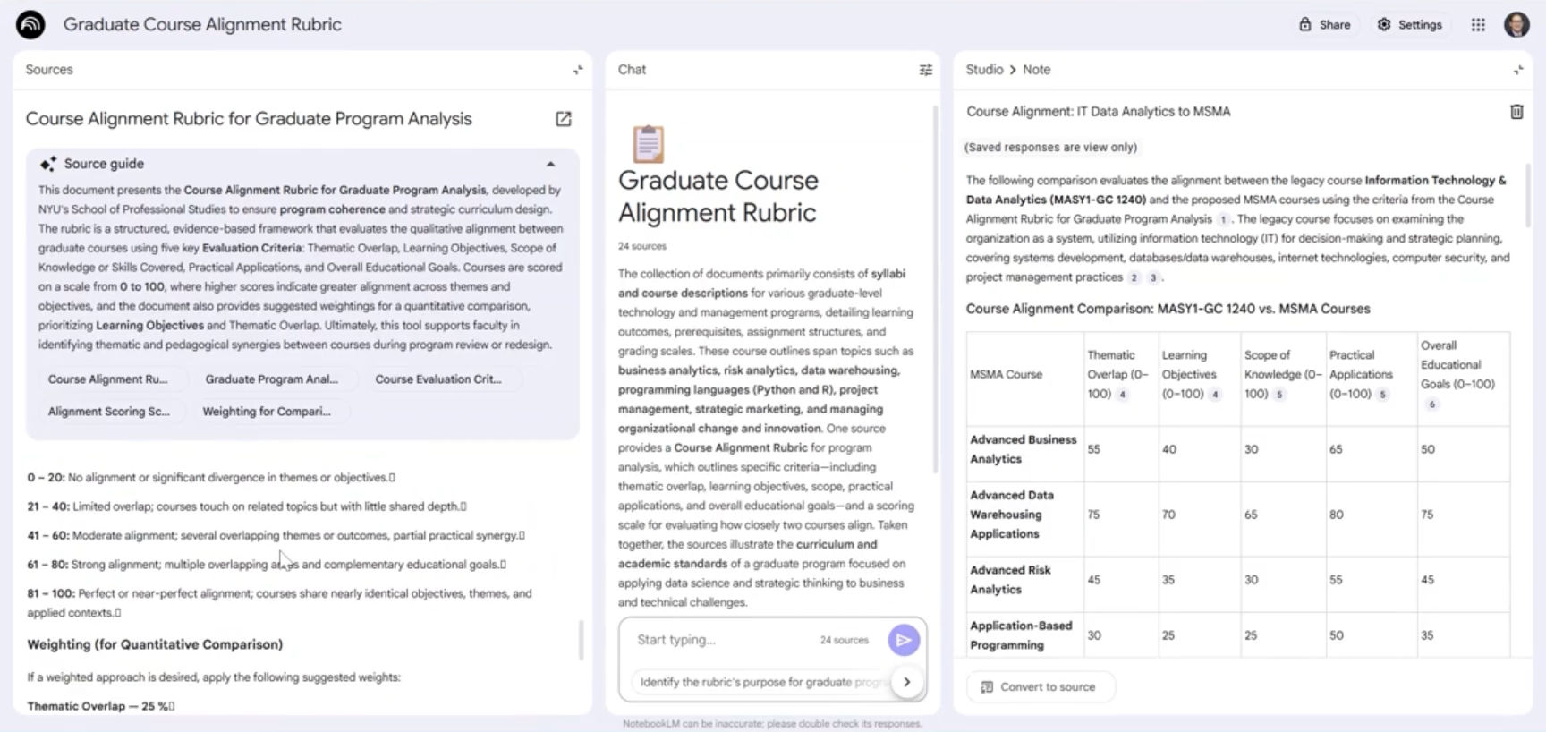
NotebookLM for Administration
NotebookLM to Support Academic Program Revisions
Negar Farakish, NYU SPS Asst. Dean, Division of Programs in Business & Clinical Associate Prof.
Paul Goncalves, NYU SPS Admin. Director of Mgt. & Technology Programs

Slide 6
NotebookLM for Administration
Other Featured Use Cases
Building Interactive Academic Policies and Governance Chatbots
Managing Administrative Handbooks, and Faculty Resources
Data-Driven Auditing of the Applicant Screening Process

Slide 7
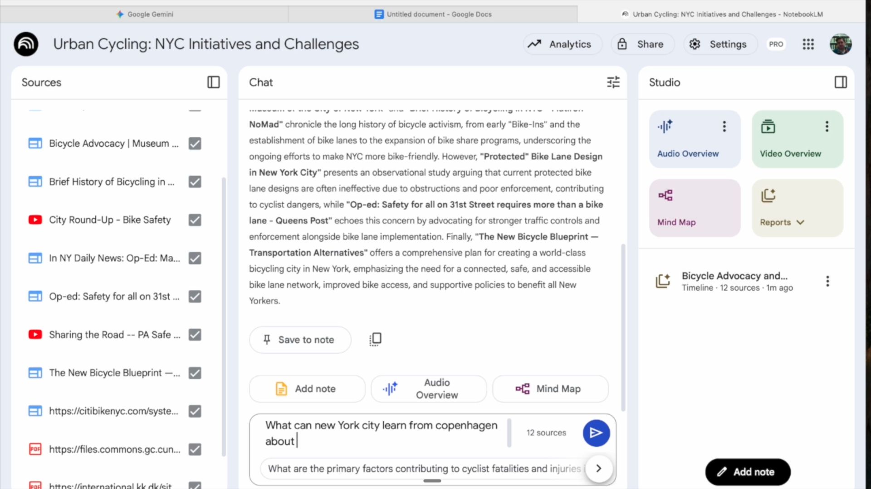
NotebookLM as a Research Partner
NotebookLM As A Research Tool For An Intro To Public Policy Course
Thom Blaylock NYU Wagner Clinical Professor of Public Service

Slide 8
NotebookLM as a Research Partner
Other Featured Use Cases
Extracting and Representing Data from PDFs
Comparing Multilingual Sources from Different Cultural Policies

Slide 9
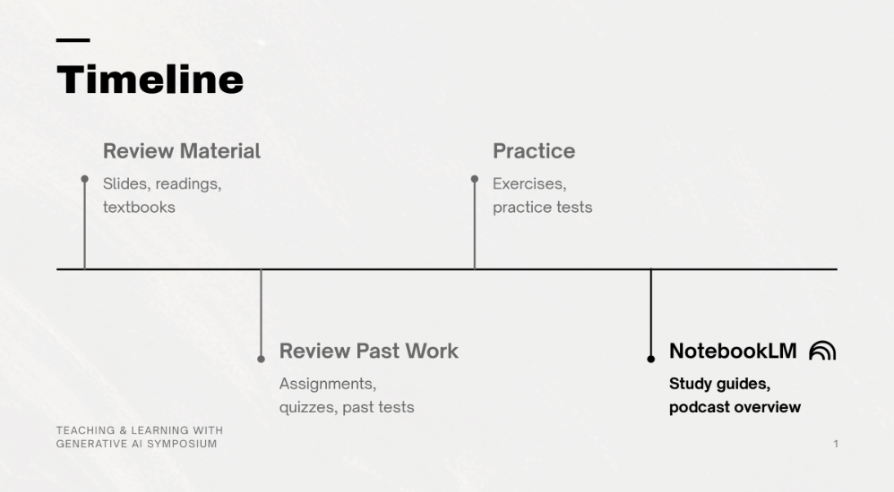
Studying with NotebookLM
Personalized Study Guides & Podcasts with NotebookLM Hanwen Zhang NYU Arts and Science BA, Computer Science and Data Science, ’26

Slide 10
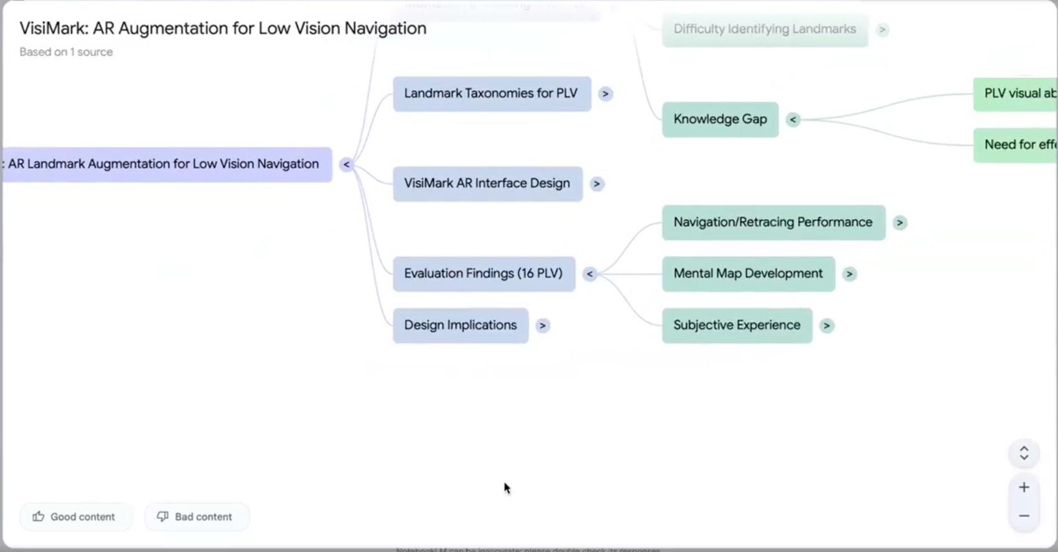
Studying with NotebookLM
NotebookLM for Literature Reviews
George Wang NYU Steinhardt MA, Learning Technology Experience and Design (LTXD), ‘26

